Slide 1
Optimized Hiring Strategies for Full-Stack Engineers
Insights to optimize hiring decisions.
Name – Ajay Landge

Slide 2


Introduction
Objective and Key areas covered
To provide market insights on Full-Stack Engineer availability and hiring trends in India for an upcoming project.
Talent availability
Average salaries
Emerging locations
Candidate preference
Salary trend and structure
Top hiring companies
Industry demand for skills
Recommendation

Slide 3








Commonly Used Job Titles in Full-Stack Hiring
Full-Stack Software Engineer
Software Engineer (Full-Stack)
Full-Stack Web Developer
Full-Stack Application Developer
Full-Stack Java Developer (for Java-heavy roles)
Full-Stack React Developer (for React-focused roles)
Frontend + Backend Developer
MEAN/MERN Stack Developer

Slide 4


Talent Pool Availability Across India
10K+
40.5K
Degree Holders
Total candidate
This analysis considers multiple factors, including:
Work Mode, Geographical Distribution, Salary Trends, Company Type, Education and Top Hiring Companies.

Slide 5


Average Compensation Trends Across Key Cities
Key Takeaways for Decision-Making:
Bangalore is ideal for attracting top-tier tech talent but comes with higher hiring costs.
Chennai and Delhi offer a balance of affordability and skilled talent, making them suitable for cost-effective hiring.
Mumbai provides opportunities for Full-Stack Engineers, but salaries are relatively lower, making it a viable choice for budget-conscious hiring.
40.5K
Avg CTC
Strategic Insights for Talent Acquisition: To optimize recruitment budgets, companies can explore remote hiring strategies or establish tech teams in cost-efficient cities while maintaining key operations in high-demand hubs.

Slide 6

City-Wise Hiring Recommendations
For Immediate Hiring: Focus on Bangalore and Delhi, as they have the highest number of candidates, but be prepared for intense competition.
For Cost-Effective Hiring: Explore Mumbai, where the talent pool is moderate, and competition is lower than in Delhi and Bangalore.
For Long-Term Talent Development: Chennai may require additional sourcing strategies, such as hiring fresh graduates or offering remote work opportunities.
Delhi and Bangalore: High Competition Mumbai: Medium Competition Chennai: Low Supply, High Demand

Slide 7
Emerging Locations with Growing Talent Pool
Chennai presents an opportunity for companies seeking cost-effective hiring with less competition. However, additional training may be needed for talent development.
Mumbai is an attractive alternative for companies looking for tech talent but competition is growing.
Hiring in Delhi provides access to a skilled workforce but requires competitive compensation and strong employer branding to attract talent.

Slide 8
Candidate Preferences: Hybrid, Remote, and On-Site Work Models
50% Full-Stack Engineers prefer Hybrid
50%
30%
30% Full-Stack Engineers prefer Remote working.
Demand for flexible work is high, especially in metro cities like Bangalore, Delhi NCR, and Mumbai.
Companies offering flexibility have a competitive edge in attracting top talent.
Source: LinkedIn Insights, Naukri Hiring Trends, Glassdoor Reviews, Hiring Manager Feedback (2024)

Slide 9
Candidate Preferences: Hybrid, Remote, and On-Site Work Models
50% Full-Stack Engineers prefer Hybrid
50%
20%
20% Full-Stack Engineers prefer on-site working.
For on-site roles, consider offering partial hybrid models to remain competitive.
Prioritize hybrid/remote options during hiring.
Source: LinkedIn Insights, Naukri Hiring Trends, Glassdoor Reviews, Hiring Manager Feedback (2024)

Slide 10

Salary Structure Breakdown
Insights:
Companies in metro cities offer stock options and higher bonuses to retain top talent.
Startups attract candidates with equity-based compensation.
MNCs provide structured bonuses tied to performance and seniority.

Slide 11
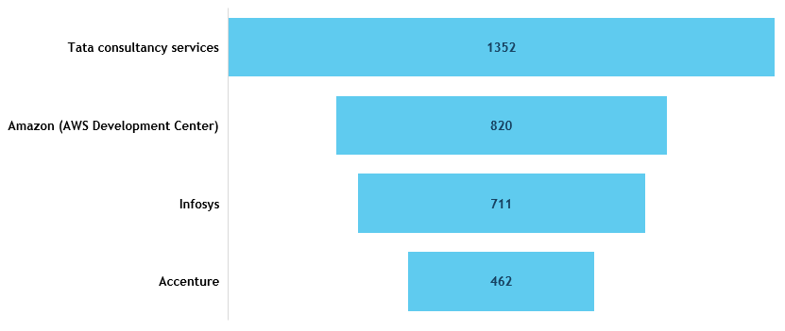
Leading Companies Hiring Full-Stack Engineers
The chart highlights that TCS, Amazon (AWS Development Center), Infosys, and Accenture are currently leading the recruitment of Full-Stack Engineers.

Slide 12

Critical Hiring Factors for Full-Stack Roles
Project-Based Hiring Approaches
Balancing Budget and Skill Requirements
Strategies for Long-Term Talent Retention

Slide 13
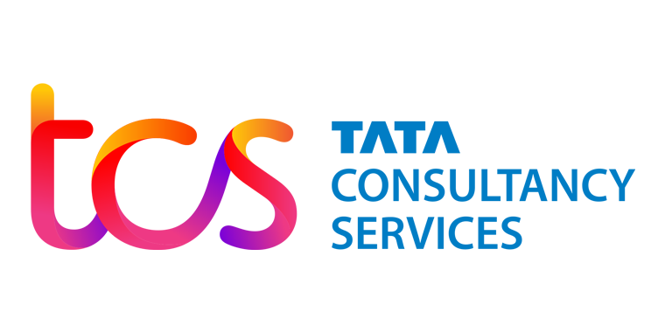





Active Employers Aggressively Hiring Full-Stack Engineers
These companies are recognized for their robust hiring practices in the Full-Stack development domain, offering numerous opportunities for professionals in this field.

Slide 14
In-Demand Skills and Frameworks for Full-Stack Engineers
Key Skills in demand
90%
Javascript
JavaScript is the most demanded skill. It is an essential core skill for candidates.
85%
Java
Java continues to be highly relevant, especially for backend-heavy full-stack positions and enterprise-level applications.
80%
React.js
React.js is widely used for frontend development
75%
RESTful APIs
API design and integration skills are critical.
50%
Ruby
Ruby has moderate demand, often linked to legacy systems or specific companies (e.g., startups using Ruby on Rails)

Slide 15
Role of Certifications in Full-Stack Hiring
Cloud Certifications (AWS, Google Cloud, Azure) | Full-Stack Development Bootcamps | DevOps and Deployment Certifications (Docker, Kubernetes, Jenkins)
Should Certifications Be Mandatory? Not always, but they enhance candidate credibility.
Competitive Hiring Strategy:
Offer sponsorship for cloud certifications as an incentive.
Encourage employees to upskill via bootcamps for continuous growth.
Create an evaluation matrix combining degrees, experience, and certifications for better hiring decisions.

Slide 16

Recommendations
Recommended Hiring Strategies
Strategy to Find the Right Fit
Target Emerging Cities: Chennai, Mumbai, Delhi offer good talent at lower cost.
Remote Hiring: Expands access to PAN India.
Skill-Based Hiring: Focus on practical tests and portfolio reviews instead of only years of experience.
Campus Hiring: For entry to mid-level roles, focus on hiring from Tier 1 and 2 colleges.
Upskilling Programs: Partner with bootcamps or training providers to groom talent.
Leverage remote and hybrid hiring to widen the talent pool.
Prioritize candidates skilled in React, Node.js, REST APIs, and Cloud.
Explore talent from Chennai and Mumbai to balance cost and availability.
Conduct technical assessments to identify high-potential candidates.

Slide 17
Questions and Answer

Slide 18
Thank You!

